Slide 1
Key Points
Introduction to Computers: Introduction, Characteristics of Computers, Block diagram of computer. Types of computers and features, Mini Computers, Micro Computers, Mainframe Computers, Super Computers. Types of Programming Languages (Machine Languages, Assembly Languages, High Level Languages). Data Organization, Drives, Files, Directories. Types of Memory (Primary And Secondary) RAM ROM, PROM, and EPROM. Secondary Storage Devices (FD, CD, HD, Pen drive) I/O Devices (Scanners, Plotters, LCD, Plasma Display) Number Systems Introduction to Binary, Octal, Hexadecimal system Conversion, Simple Addition, Subtraction, Multiplication.

Slide 2
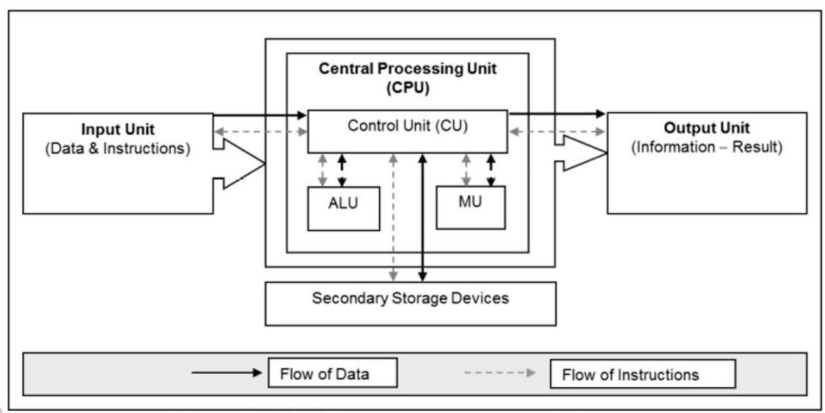
Introduction to computer
Characteristics of Computers
Block Diagram of computer system
High-Speed Calculation.
Automatic Execution
Versatility
Data Storage
Accuracy

Slide 3
Types of Computers
By size
By mechanism
By purpose / Use
Super
Analog
General
Mainframe
Digital
Special
Mini
Hybrid
Generation
Fifth Generation (Present and Beyond)
Mega Chips
Parallel Processing
AI
Micro
Second Generation (1950s-1960s)
Fourth Generation (1970s-Present)
Third Generation (1960s-1970s)
First Generation (1940s-1950s)
Transistors for circuitry
Magnetic Drums
Punched Cards
Assembly Language
IC’s
Silicon
Keyboards
monitor
Microprocessors
Semiconductor Memory
IC’s
GUI
Vacuum Tubes
Magnetic Drums
Punched Cards
0 & 1

Slide 4
Types of Programming Languages
Machine Languages
Assembly Languages
High-Level Languages
Example: Binary code like `11001001`.
- Example:
x86 assembly language
(Used for Intel and AMD processors.)
ARM assembly language
(used for ARM processors)
PowerPC assembly language
(used for PowerPC processors)
- Examples:
- Procedural Languages:
(C, python, Java, JavaScript, C++)
Object-Oriented Languages:
(Smalltalk, Java, python JavaScript, C++)
Scripting Languages:
(Bash, JavaScript, python, java, C++)
- Functional Languages:
(Haskell, python, java, JavaScript, C++ )

Slide 5
A.L.U
C.P.U
(Non-volatile)
ROM
PROM
EPROM
EEPROM
C.U
Primary Storage
Memory
(Volatile)
RAM
DRAM
SRAM
I.P.M
Secondary Storage
Cash
reserve
Directories (Folders)
Data organization
Devices
(Non-volatile)
SSD
HDD
Pen drive
USB Flash Drives
CD
Files

Slide 6
I/O Devices
(Output Devices)
(Input Devices)
Plotters
Scanners
LCD (Liquid Crystal Display)
Plasma Displays

Slide 7
Binary Subtraction:
Example: 1101
- 1011
1 - 1 = 0
0 - 1 = -1 (borrow 1 from next digit: becomes 10 - 1 = 1)
( 1 = 0) = borrow 1
0 - 0 = 0
1 - 1 = 0
Final result: 0010 (or simply 10)
Binary Addition:
Example:
0+0 =0
0+1=1
1+1=0 (carry 1)
1+1+1=0 (carry 1)
And so on……...
Example: 1011
+ 1101
1 + 1 = 10 (0 carry 1)
1 + 0 + 1 (carry) = 10 (0 carry 1)
0 + 1 + 1 (carry) = 10 (0 carry 1)
1 + 1 (carry) = 10 (0 carry 1)
Final result: 11000
Multiplication
Binary Multiplication:
Example: 101 * 11
101 × 1 = 101
101 × 10 = 1010
Add the results: 101 + 1010 = 1111
Decimal to Binary
Example: Convert 13 to binary.
13 ÷ 2 = 6 remainder 1
6 ÷ 2 = 3 remainder 0
3 ÷ 2 = 1 remainder 1
1 ÷ 2 = 0 remainder 1
So, 13 in binary is 1101.
Binary to Decimal
Example: Convert 1101 to decimal.
1 × 2³ + 1 × 2² + 0 × 2¹ + 1 × 2⁰
8 + 4 + 0 + 1 = 13
Decimal to Octal
Example: Convert 65 to octal.
65 ÷ 8 = 8 remainder 1
8 ÷ 8 = 1 remainder 0
1 ÷ 8 = 0 remainder 1
So, 65 in octal is 101.
Octal to Decimal
Example: Convert 101 to decimal.
1 × 8² + 0 × 8¹ + 1 × 8⁰
64 + 0 + 1 = 65
Number Systems Introduction
Decimal to Hexadecimal
Example: Convert 255 to hexadecimal.
255 ÷ 16 = 15 remainder 15 (F)
15 ÷ 16 = 0 remainder 15 (F)
So, 255 in hexadecimal is FF.
Hexadecimal to Decimal
Example: Convert 2F to decimal.
2 × 16¹ + F ×16⁰
2 × 16 + 15 × 1
32 + 15 = 47
Binary System (Base 2)
Decimal System (Base 10)
Conversion
Octal System (Base 8)
Hexadecimal System (Base 16)

